Slide 1

AI-Powered Legal Document Review System
Multi-Agent Architecture leveraging Azure AI Foundry for intelligent contract analysis and compliance validation

Slide 2





Enterprise Legal Review Platform
Azure AI Agent Service
Azure AI Foundry
Azure AI Search (RAG)
Intelligent orchestration and task management
Enterprise-grade AI development platform
Grounded retrieval from legal precedents
Azure Blob Storage
Semantic Kernel
Secure document repository
AI orchestration framework
Prepared by: Gopal Gupta, Devraj, Sridhar

Slide 3

The Challenge: Manual Legal Review at Scale
Business Problem
Strategic Objective
Traditional legal document review presents significant operational challenges:
Deploy an AI-powered intelligent system that transforms legal operations:
Time-intensive processes: Hours per document
Automated document review workflows
Human error exposure: Inconsistent analysis
Precision clause extraction
Proactive compliance risk flagging
Scalability constraints: Limited by headcount
Context-aware summaries grounded in legal precedents
Resource dependency: Requires specialized expertise

Slide 4

Solution: Intelligent Multi-Agent Architecture
Proposed Solution
Key Business Benefits
A sophisticated Multi-Agent AI System engineered for enterprise legal operations:
80%
95%
Decomposed workflows into specialized agent tasks
Powered by Azure AI Agents for modular processing
Faster Reviews
Risk Reduction
Enhanced with Retrieval-Augmented Generation (RAG) for accuracy
Built for scalability and seamless extensibility
Reduced processing time
Compliance accuracy
100%
Consistency
Standardized analysis
Easy integration with existing enterprise systems and workflows

Slide 5
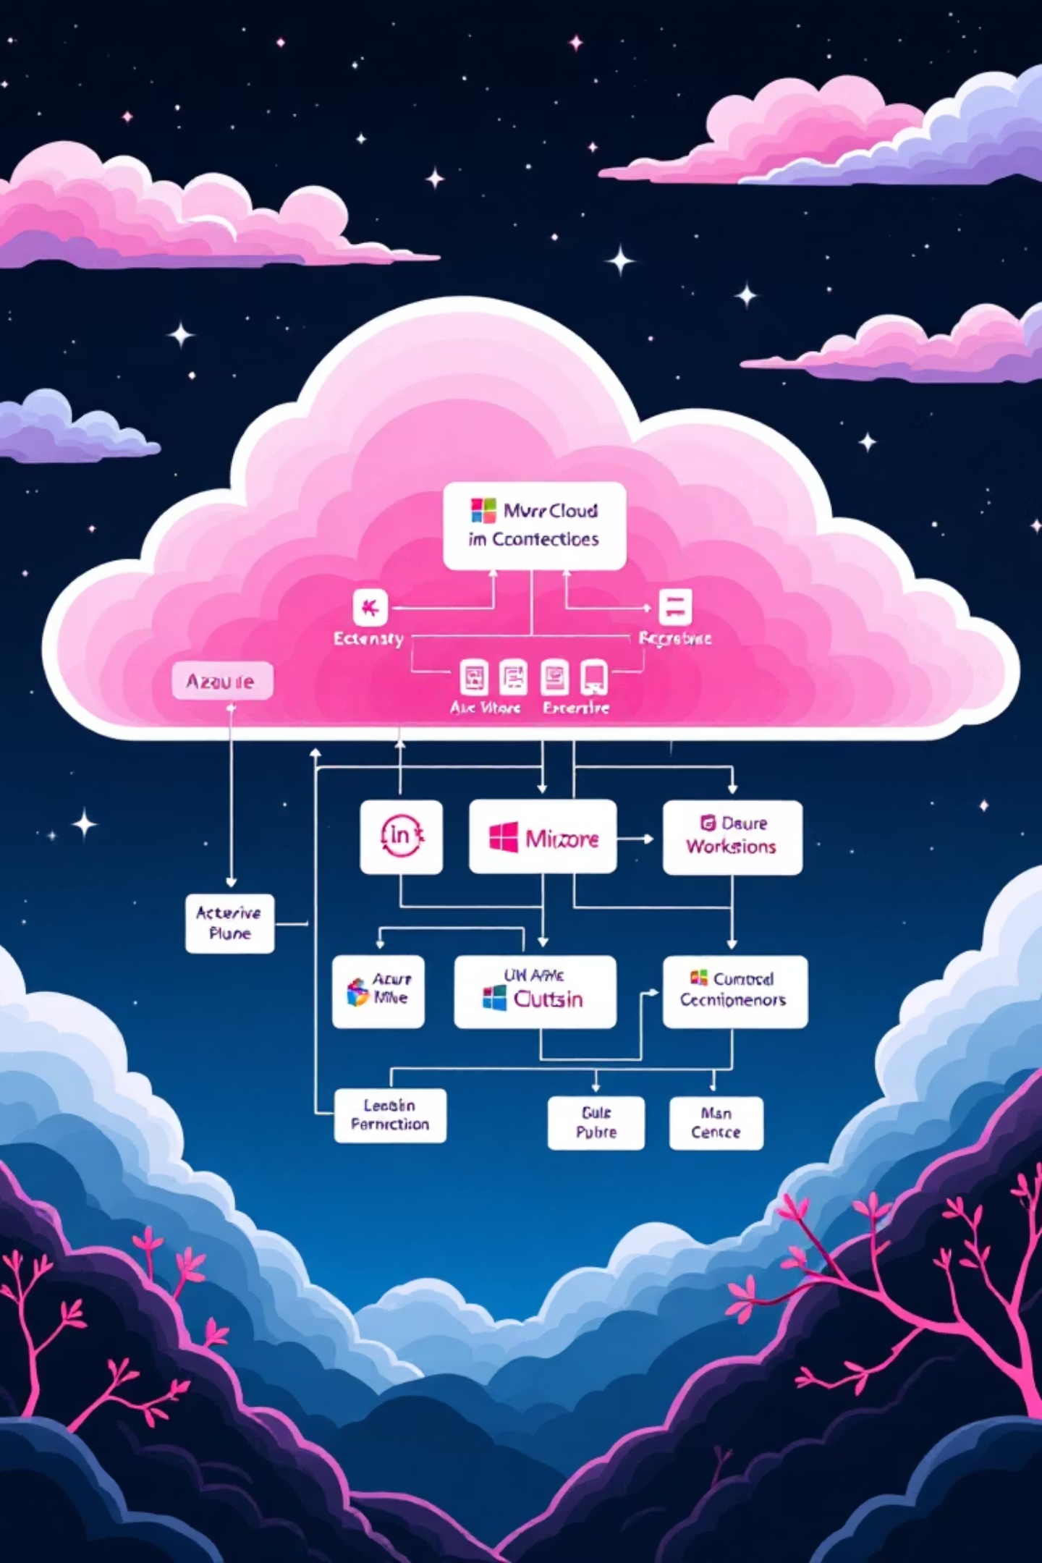
System Architecture Components
01
User Interface Layer
CLI for immediate deployment, with PowerApps and Web UI planned for enhanced accessibility
02
Azure AI Foundry
Central orchestration hub managing AI agent lifecycle, deployment, and coordination
03
Specialized AI Agents
Document Classification • Clause Extraction • Compliance Validation • Summary & Explanation
04
Knowledge & Storage Layer
Azure AI Search for legal precedent retrieval combined with Azure Blob Storage for secure document management

Slide 6






Multi-Agent System Architecture
User Input
Document submission via interface
Legal Review Orchestrator Agent
Central coordinator managing workflow and agent communication
Specialized Processing Agents
Document Classification → Clause Extraction → Compliance Validation → Summary Generation
Knowledge Integration
Azure AI Search (Legal Precedents) + Azure Blob Storage (Documents)
This architecture enables parallel processing and modular scaling as organizational needs evolve

Slide 7
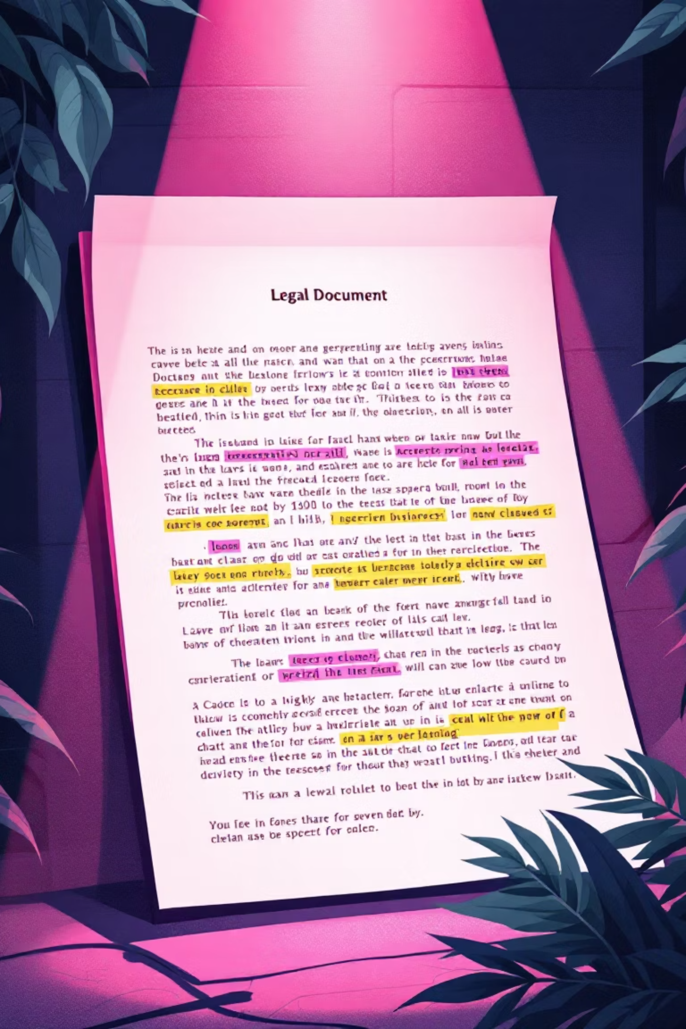
Agent Capabilities: Classification & Extraction
Document Classification Agent
Clause Extraction Agent
Extracts critical provisions:
Core Functions:
Termination conditions and notice periods
Identifies document type (NDA, Service Agreement, Employment Contract)
1
Liability limitations and caps
1
Determines jurisdiction and governing law
Indemnity obligations
Governing law and dispute resolution
Categorizes by industry and complexity
Confidentiality and non-disclosure terms

Slide 8

Agent Capabilities: Validation & Summary
Compliance Validation Agent
Risk Assessment Functions:
Identifies missing standard clauses
Flags high-risk or one-sided terms
Detects ambiguous legal language
Assigns risk levels: High / Medium / Low
Summary & Explanation Agent
Intelligent Output Generation:
Plain-English legal summaries
Actionable risk explanations with context
Leverages RAG for grounded, precedent-based insights
Provides strategic recommendations

Slide 9





End-to-End Workflow Process
Document Submission
User initiates review by uploading legal document through secure interface
Orchestration
Orchestrator agent receives document and initiates multi-agent workflow sequence
Specialized Analysis
Each agent performs focused analysis: classification, extraction, validation in coordinated sequence
Knowledge Retrieval
RAG system queries legal precedents from Azure AI Search for contextual grounding
Report Generation
Final comprehensive compliance summary with risk assessment and recommendations delivered

Slide 10

Detailed Workflow: Initial Processing Steps
1
Step 1: Document Submission
User uploads contract file or pastes legal document text directly into the system interface. System validates format and initiates secure processing pipeline.
2
Step 2: Document Understanding
Classification agent analyzes structure and content to identify document type (NDA, MSA, Employment Agreement) and determines applicable jurisdiction for compliance rules.
3
Step 3: Clause Extraction
Extraction agent performs deep analysis to identify and structure all key legal provisions, creating a comprehensive map of contractual obligations and rights.
This foundation enables subsequent compliance validation and risk assessment by specialized agents downstream in the workflow.

